Slide 1
Propositional Logic
Jinghao Zhao
11/20/2020

Slide 2
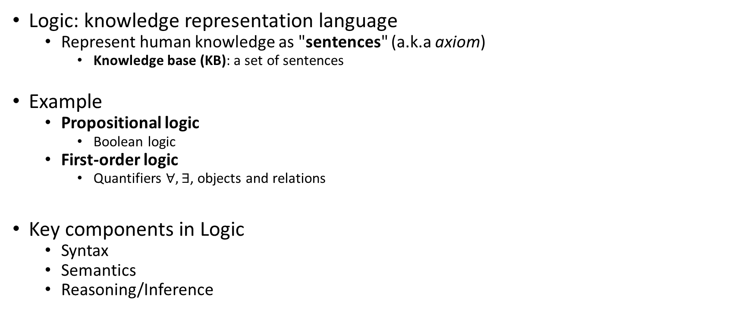
Logic
Logic: knowledge representation language
Represent human knowledge as "sentences" (a.k.a axiom)
Knowledge base (KB): a set of sentences
Example
Propositional logic
Boolean logic
First-order logic
Quantifiers $∀, ∃$, objects and relations
Key components in Logic
Syntax
Semantics
Reasoning/Inference

Slide 3
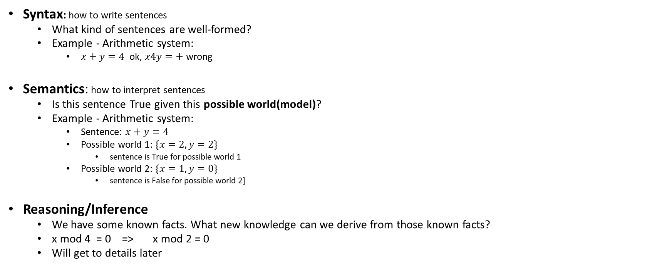
Key Components of Logic
Syntax: how to write sentences
What kind of sentences are well-formed?
Example - Arithmetic system:
$x+y=4$ ok, $x4y=+$ wrong
Semantics: how to interpret sentences
Is this sentence True given this possible world(model)?
Example - Arithmetic system:
Sentence: $x+y=4$
Possible world 1: $\{x=2, y=2\}$
sentence is True for possible world 1
Possible world 2: $\{x=1, y=0\}$
sentence is False for possible world 2]
Reasoning/Inference
We have some known facts. What new knowledge can we derive from those known facts?
x mod 4 = 0 => x mod 2 = 0
Will get to details later

Slide 4
Propositional Logic
A.k.a. Boolean logic
Syntax
Semantics
Inference - Entailment
How to prove it?
Proof by enumeration – Model Checking
Theorem proving – Proof by refutation (use resolution)

Slide 5

Syntax
Atomic sentence
A single propositional symbol, like $A$ (A can be True or False)
Logical connectives
$¬$ not
$∧$ and (conjunction)
$∨$ or (disjunction)
$⇒(or→)$ implication
$⟺$ if and only if
Complex sentence
$A∨B, A∨¬C⇒B$, ...
A special type of sentence: Horn clause

Slide 6
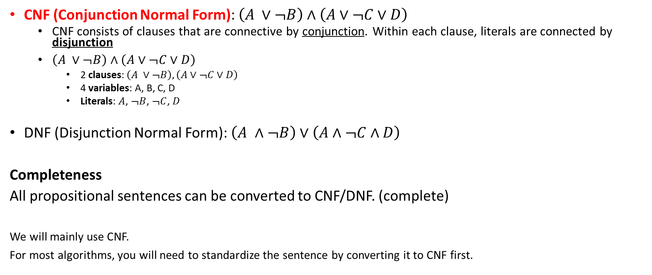
Syntactic Forms – CNF, DNF
CNF (Conjunction Normal Form): $\left(A ∨¬B\right)∧\left(A∨¬C∨D\right)$
CNF consists of clauses that are connective by conjunction. Within each clause, literals are connected by disjunction
$\left(A ∨¬B\right)∧\left(A∨¬C∨D\right)$
2 clauses: $\left(A ∨¬B\right),\left(A∨¬C∨D\right)$
4 variables: A, B, C, D
Literals: $A$, $¬B$, $¬C$, $D$
DNF (Disjunction Normal Form): $\left(A ∧¬B\right)∨\left(A∧¬C∧D\right)$
Completeness
All propositional sentences can be converted to CNF/DNF. (complete)
We will mainly use CNF.
For most algorithms, you will need to standardize the sentence by converting it to CNF first.

Slide 7
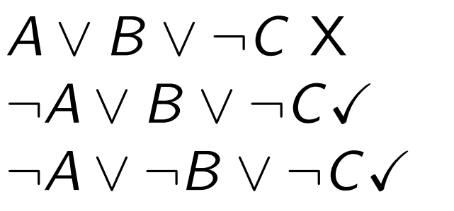

Syntactic Forms – Horn Clause
Horn clause
A subset of CNF
Each clause has at most one positive literal
Not all sentences can be converted to Horn clause! (Not complete)
Why do we care about Horn clause?
It's a special type! If the sentences are Horn clauses, inference can be done in linear time (exponential for general sentences)
$$≡A ∧C⇒B$$
A typical form
(before converting to CNF)

Slide 8
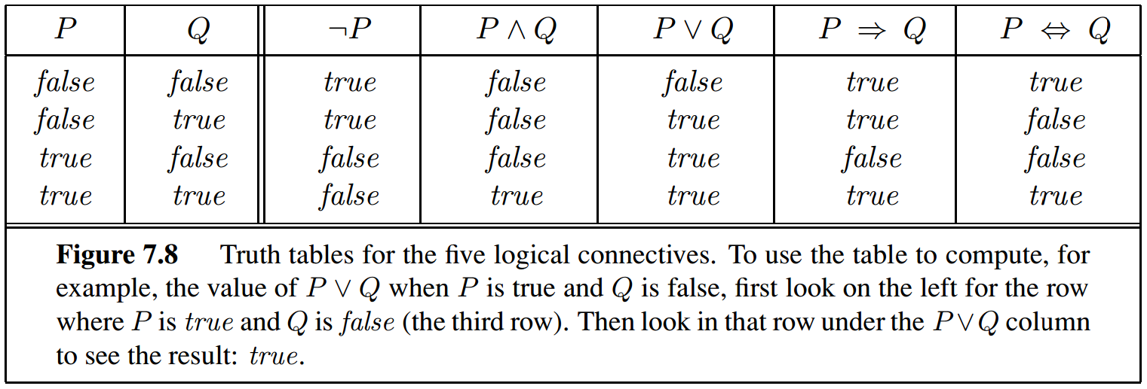
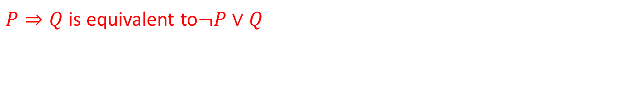
Semantics
When is this sentence True?
$P⇒Q$ is equivalent to$¬P∨Q$

Slide 9
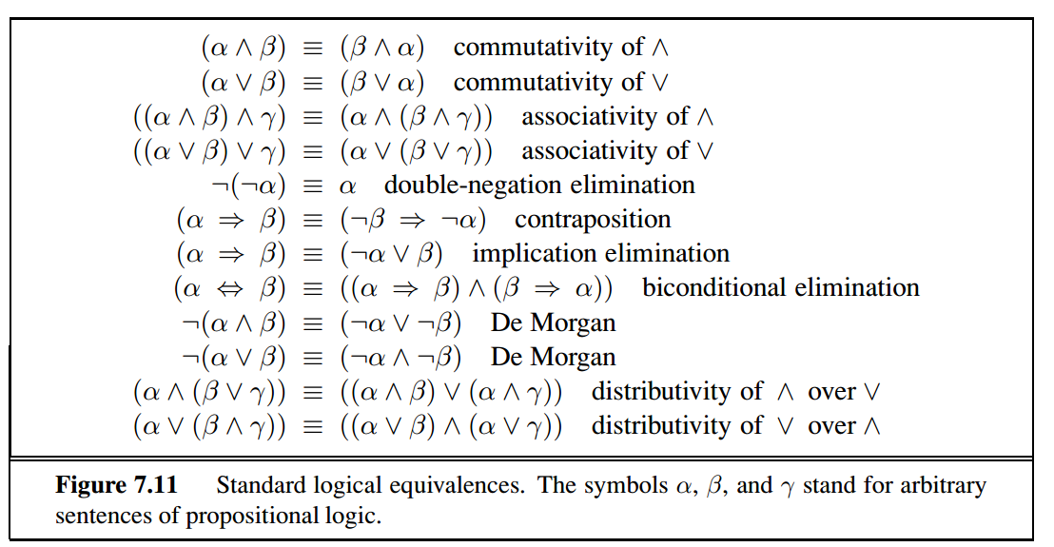
Semantics – Logical Equivalence

Slide 10

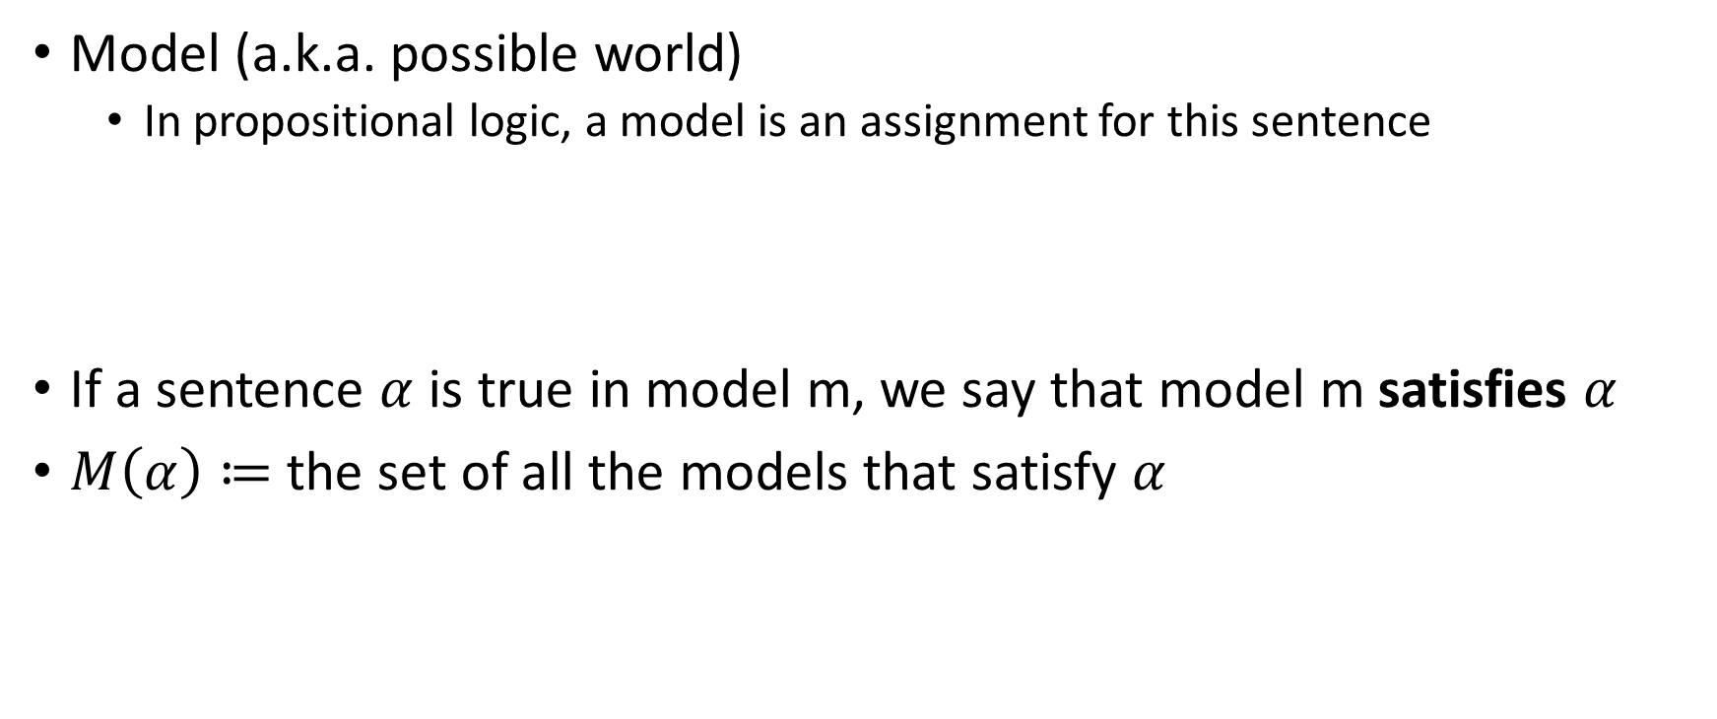
Some Very Important Definitions - Model
Model (a.k.a. possible world)
In propositional logic, a model is an assignment for this sentence
If a sentence $α$ is true in model m, we say that model m satisfies $α$
$M\left(α\right)≔$the set of all the models that satisfy $α$

Slide 11
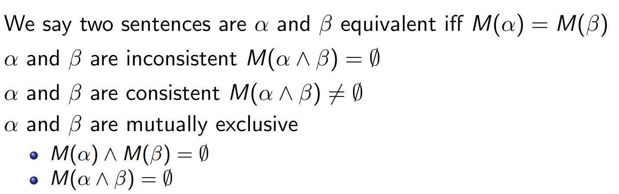
Model

Slide 12

Some Very Important Definitions
Knowledge Base $Δ$
A set of sentences $\{α_{1}, α_{2},…\}$
We can consider the whole knowledge base as a single long sentence $α_{1}∧α_{2}∧…$
All sentences are connected by conjunction

Slide 13
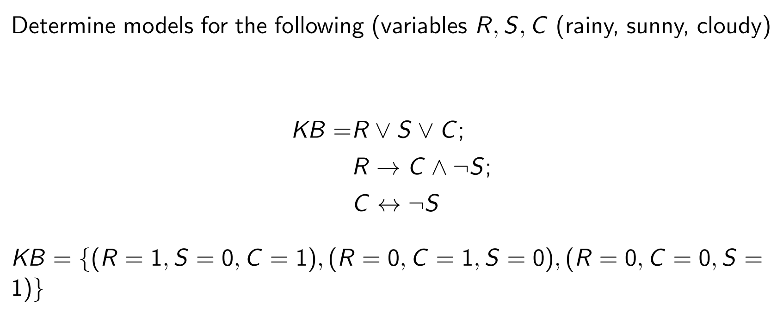
Example – Knowledge Base
(
);

Slide 14
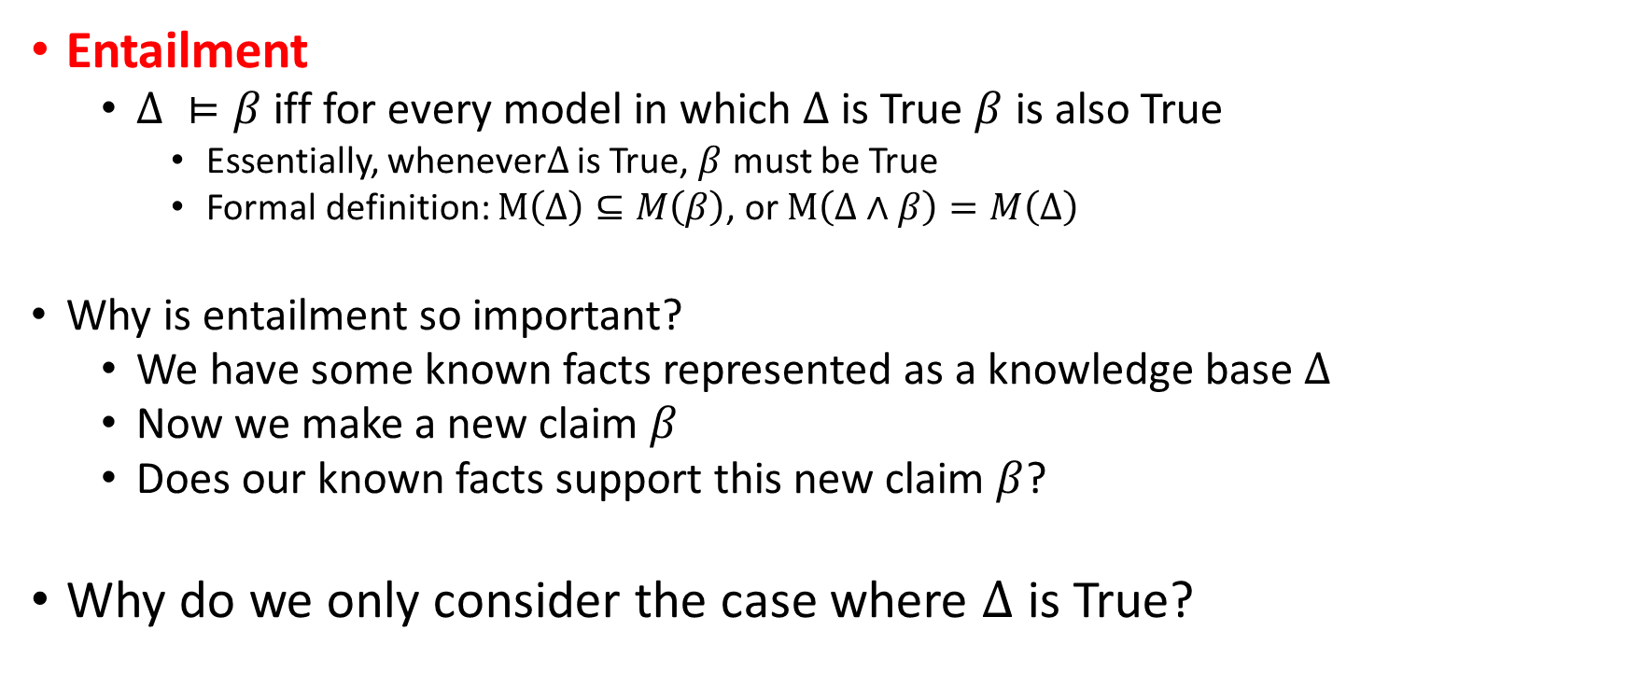
Some Very Important Definitions - Entailment
Entailment
$Δ ⊨β$ iff for every model in which $Δ$is True $β$ is also True
Essentially, whenever$Δ$ is True, $β$ must be True
Formal definition: $M\left(Δ\right)⊆M\left(β\right)$, or $M\left(Δ∧β\right)=M\left(Δ\right)$
Why is entailment so important?
We have some known facts represented as a knowledge base $Δ$
Now we make a new claim $β$
Does our known facts support this new claim $β$?
Why do we only consider the case where $Δ$ is True?

Slide 15
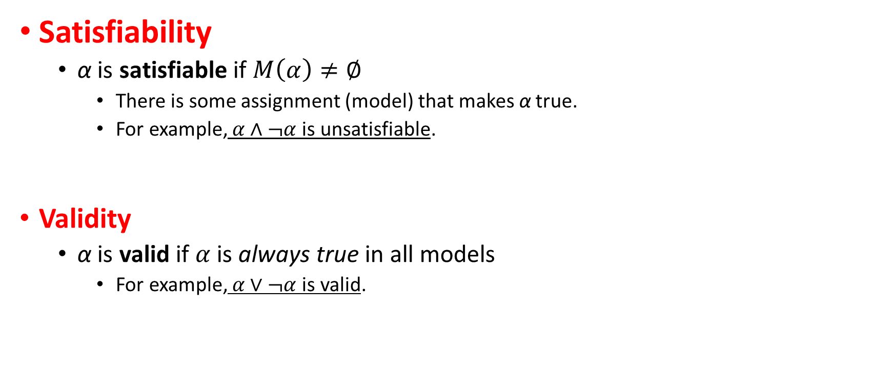
Some Very Important Definitions - Satisfiability
Satisfiability
α is satisfiable if $M\left(α\right)≠∅$
There is some assignment (model) that makes α true.
For example, $α∧¬α$is unsatisfiable.
Validity
α is valid if $α$ is always true in all models
For example, $α∨¬α$is valid.

Slide 16
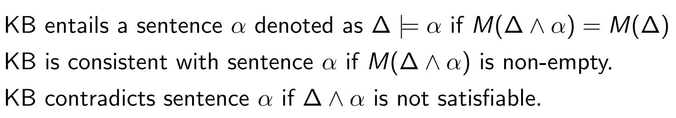
Some More Definitions

Slide 17
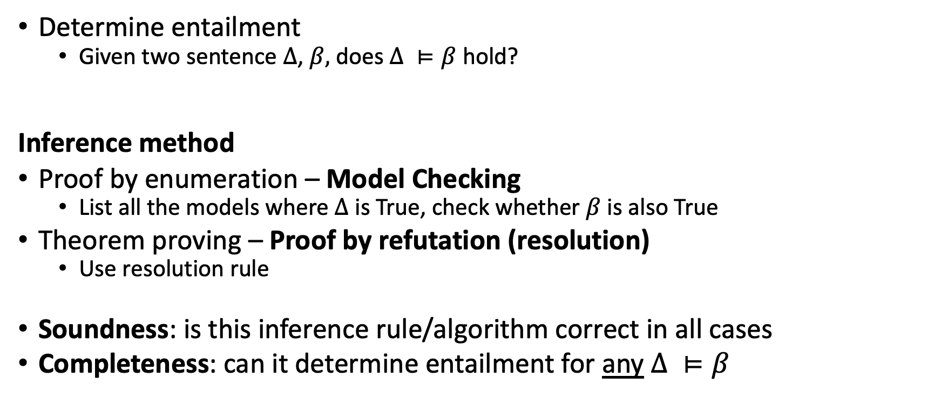
Inference
Determine entailment
Given two sentence $Δ$, $β,$does $Δ ⊨β$ hold?
Inference method
Proof by enumeration – Model Checking
List all the models where $Δ$ is True, check whether $β$ is also True
Theorem proving – Proof by refutation (resolution)
Use resolution rule
Soundness: is this inference rule/algorithm correct in all cases
Completeness: can it determine entailment for any $Δ ⊨β$

Slide 18
Equivalence Review

Slide 19
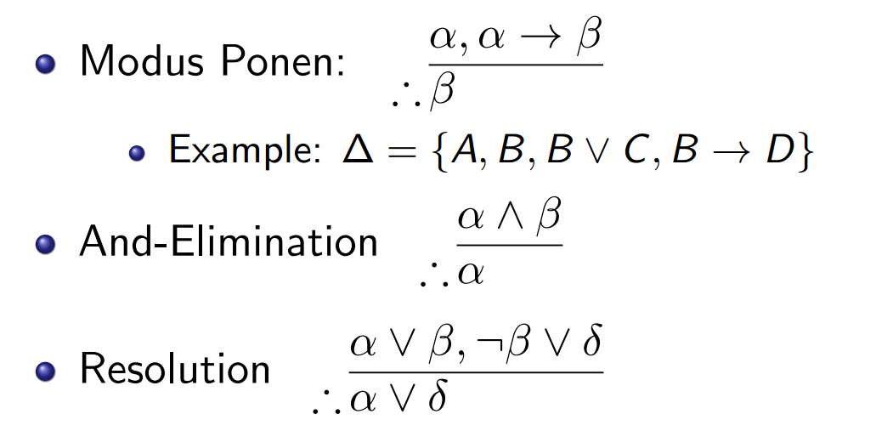

Inference Rules
We assume that we work on CNF.
We can omit the conjunction connectives among clauses and use commas.
$$(α∨β)∧(¬β∨δ)$$

Slide 20
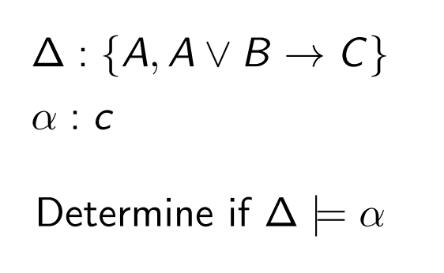
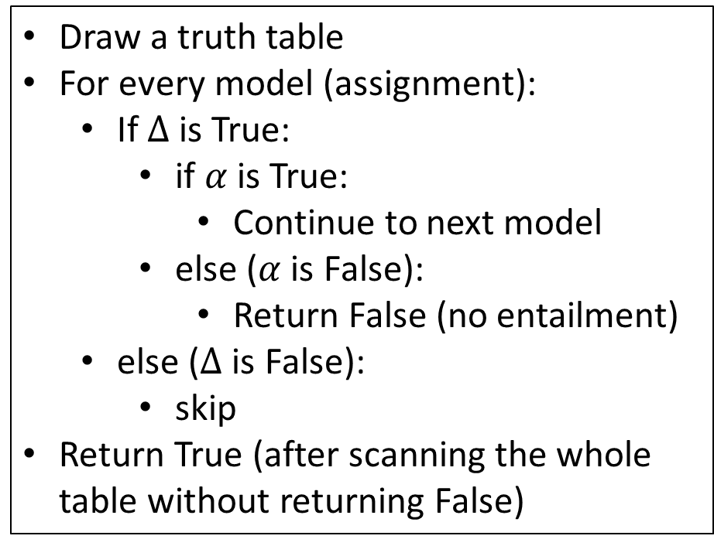
(1) Model Checking - Example
Draw a truth table
For every model (assignment):
If $Δ$ is True:
if $α$ is True:
Continue to next model
else ($α$ is False):
Return False (no entailment)
else ($Δ$ is False):
skip
Return True (after scanning the whole table without returning False)

Slide 21
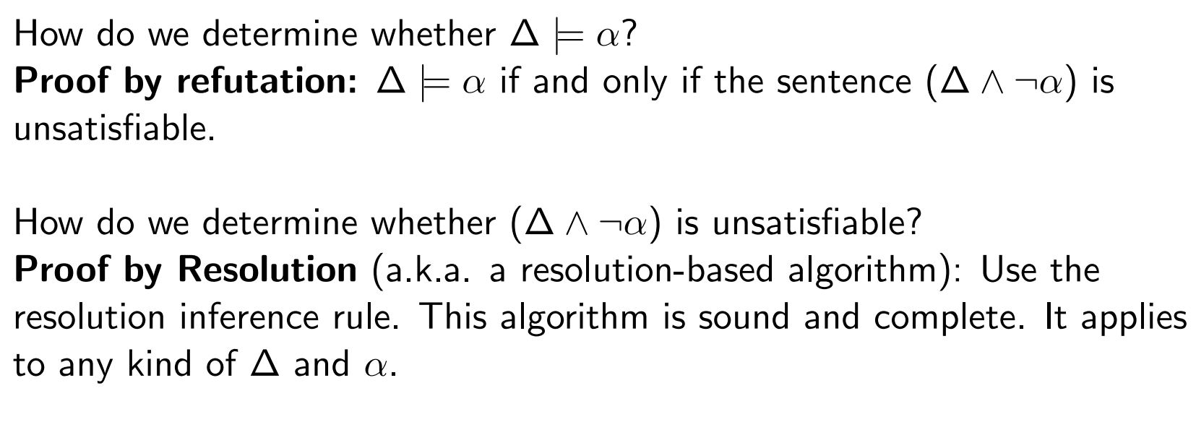
(2)Theorem Proving – Proof by Refutation (Resolution)
This algorithm is sound and complete!

Slide 22
Exercise

Slide 23
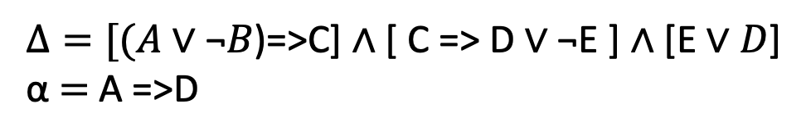
Exercise
$Δ=[($𝐴 ∨ ¬𝐵)=>C] ∧ [ C => D ∨ ¬E ] ∧ [E ∨ 𝐷]
α $=$ A =>D
¬A ∨ C
B ∨ C
¬C ∨ D ∨ ¬E
E ∨ D
A
¬D
C (1,5)
D ∨ ¬E (3,7)
E (4,6)
D (8,9)
¬E (6,8)

